Slide 1
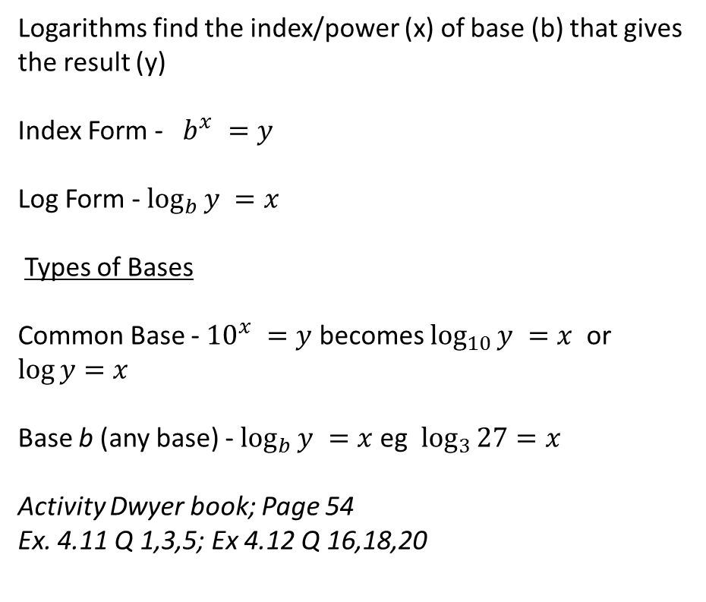
24
7
30
Date
Title - Mini Logarithm lesson 1
EQ – What are Logarithms
Logarithms find the index/power (x) of base (b) that gives the result (y)
Index Form - $b^{x} =y$
Log Form - $\log_{b}{y} =x$
Types of Bases
Common Base - ${10}^{x} =y$ becomes $\log_{10}{y} =x$ or $\log{y}=x$
Base b (any base) - $\log_{b}{y} =x$ eg $\log_{3}{27}=x$
Activity Dwyer book; Page 54
Ex. 4.11 Q 1,3,5; Ex 4.12 Q 16,18,20
5
Notes:
Input

Slide 2

24
7
30
Date
Title - Mini Logarithm lesson 1
EQ – What are the Logarithm Laws
Log laws
We know the index laws. The log laws are similar but rewritten in log form.
Index law $a^{0} =1$
Rewrite in Log Form
$$\log_{a}{1}=0$$
Index law $a^{1} =a$
Rewrite in Log form
$$\log_{a}{a} =1$$
5
Notes:
Have students rewrite in log form before showing the answer. Having students do enables them to see the link between index laws and log laws.

Slide 3
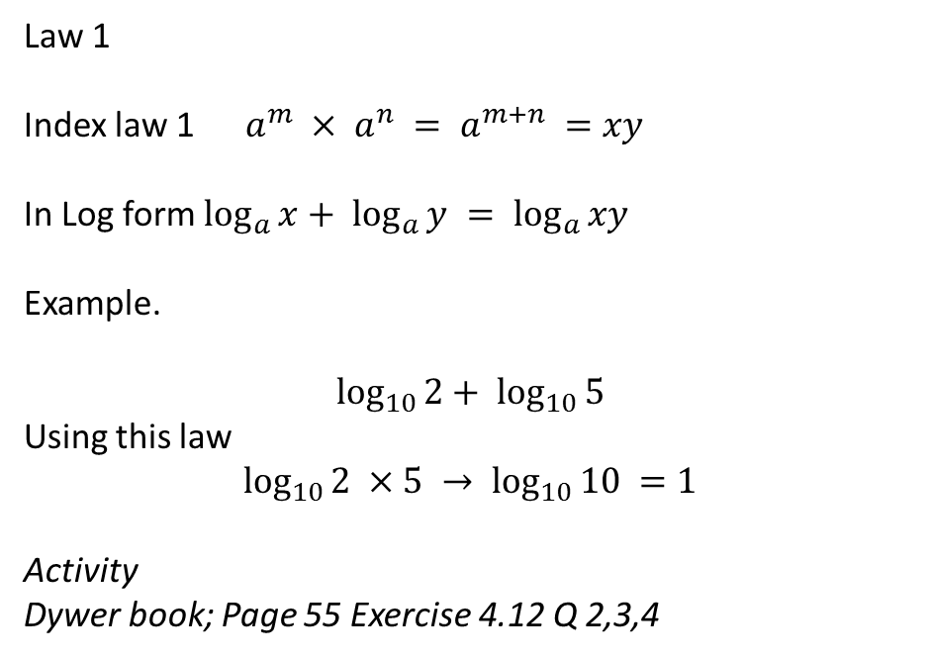
24
7
30
Date
Title - Mini Logarithm lesson 1
EQ – Logarithm Laws v’s Index Law 1
Law 1
Index law 1 $a^{m} × a^{n} = a^{m+n} =xy$
In Log form $\log_{a}{x}+ \log_{a}{y} = \log_{a}{xy}$
Example.
$$\log_{10}{2}+ \log_{10}{5}$$
Using this law
$$\log_{10}{2 ×5} → \log_{10}{10} =1$$
Activity
Dywer book; Page 55 Exercise 4.12 Q 2,3,4
5
Notes:
Input

Slide 4
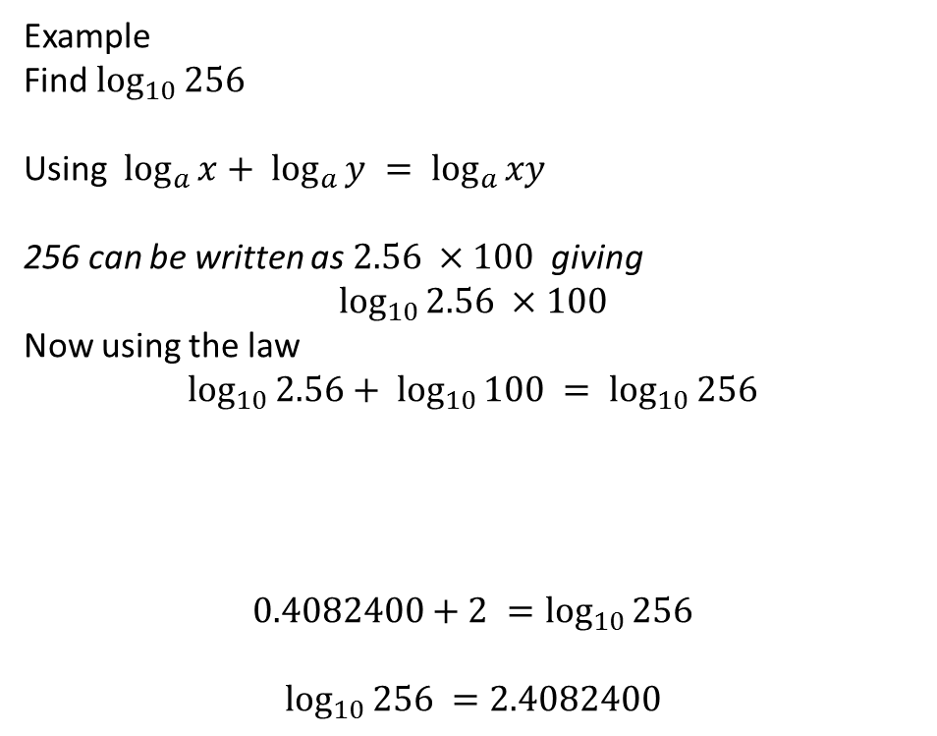
24
7
30
Date
Title - Mini Logarithm lesson 1
EQ – Logarithm Laws v’s Index Law 1
Example
Find $\log_{10}{256}$
Using $\log_{a}{x}+ \log_{a}{y} = \log_{a}{xy}$
256 can be written as $2.56 ×100$ giving
$$\log_{10}{2.56 ×100}$$
Now using the law
$$\log_{10}{2.56}+ \log_{10}{100} = \log_{10}{256}$$
$$0.4082400+2 =\log_{10}{256}$$
$$\log_{10}{256} =2.4082400$$
2.54 | 0.4048337 | 3.54 | 0.5490033 | 4.54 | 0.6570559
2.55 | 0.4065402 | 3.55 | 0.5502284 | 4.55 | 0.6580114
2.56 | 0.4082400 | 3.56 | 0.5514500 | 4.56 | 0.6589648
5
Notes:
Input

Slide 5
Activity
Nelson Chapter 1
Page 24; Q’s 4,5,6
Notes:
Independent practice

Slide 6
Closure
This lesson is on connect.
Homework – make sure your notes are complete
Complete summary
Complete questions from this lesson
Go to Mathspace and do activities you have not previously completed.
Notes:
Closure

